Slide 1
Linux Assembly
Armine Hayrapetyan

Slide 2
Outline
Command Line Arguments

Slide 3
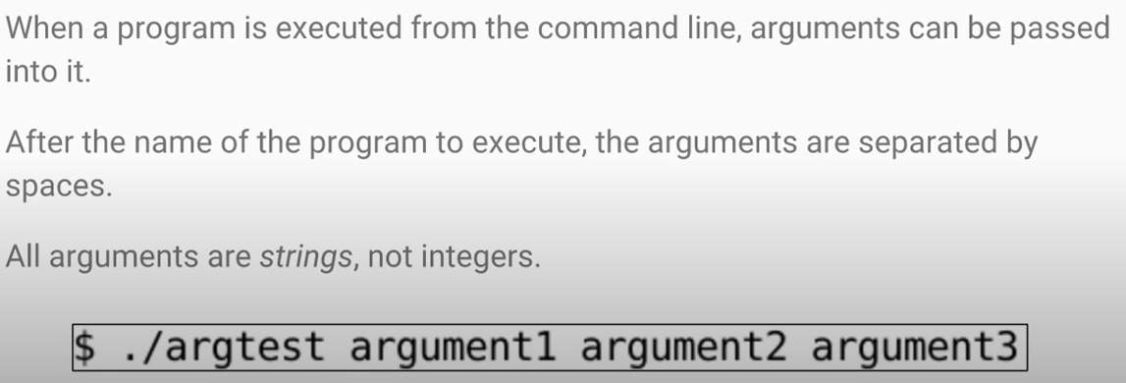
What are Command Line Arguments?

Slide 4
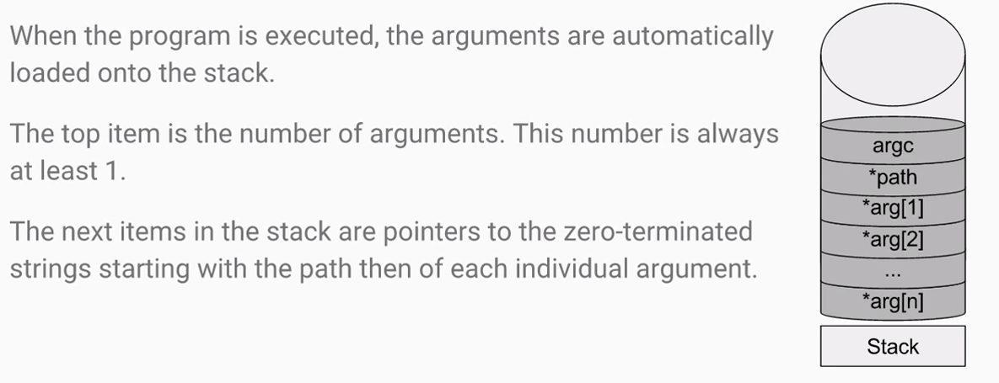
Arguments on the Stack

Slide 5
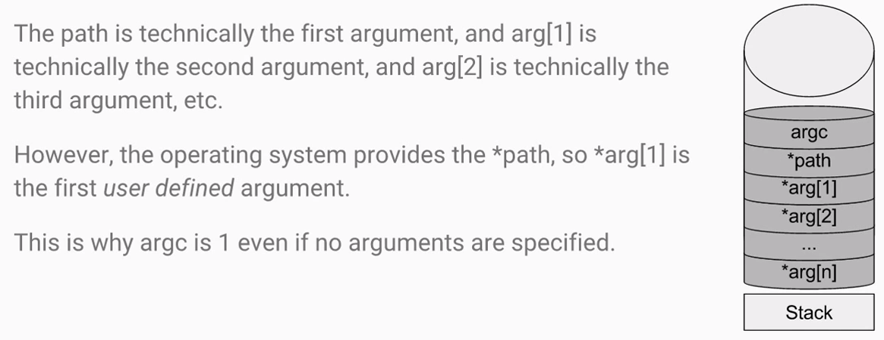
Arguments on the Stack

Slide 6
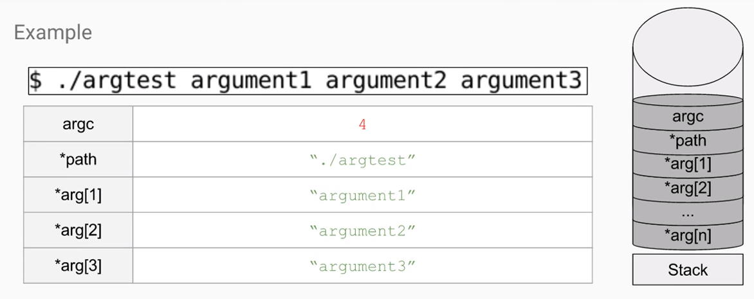
Arguments on the Stack

Slide 7
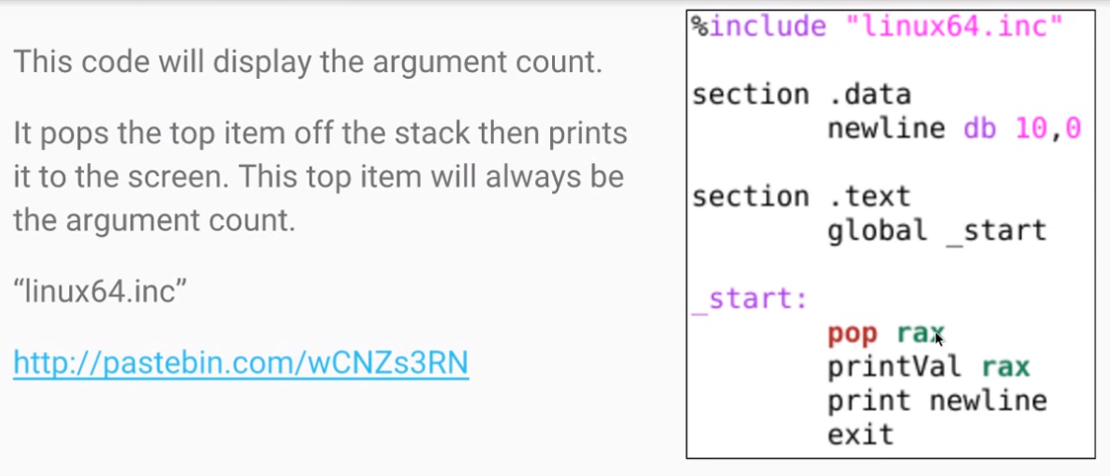
Displaying Argument Count

Slide 8
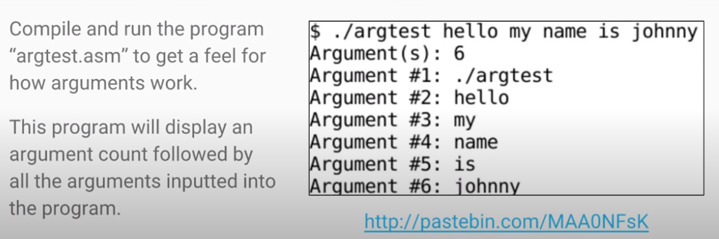
argtest

Slide 9
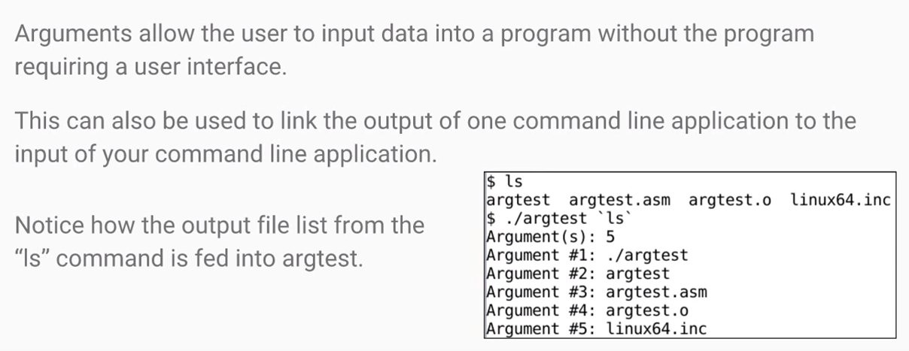
Why Arguments?

Slide 10
References
https://www.youtube.com/watch?v=xtFs1yBVinc&list=PLetF-YjXm-sCH6FrTz4AQhfH6INDQvQSn&index=9

